Slide 1
Gender Classification From Text
By: Hoang Vo -1671058
Course: COSC 6342- Machine Learning

Slide 2
Problem Statement
Statement: Given a set of labeled blogs written by males and females in English language, predict the gender of the author of a new blog.
In the internet, there are many written blogs. However, we cannot depend on names or pictures to know whether the blogs were written by men or women.
There may be many blogs in the internet that use different languages, but due to the chosen available dataset, I will narrow the problem statement within only English language.

Slide 3
Dataset
Sample blog author dataset used in [Mukherjee and Liu, EMNLP 2010] available from: http://www.cs.uic.edu/~liub/FBS/blog-gender-dataset.rar
The dataset has 2 features: blog content and author gender.
The data set consists of 3232 blogs.
Each blog is labeled with the gender of its author.
1677 (51.2%) were written by men and 1547 (48.8%) were written by women.
The average post length is 250 words for men and 330 words for women

Slide 4
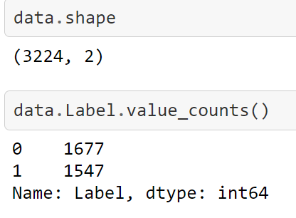
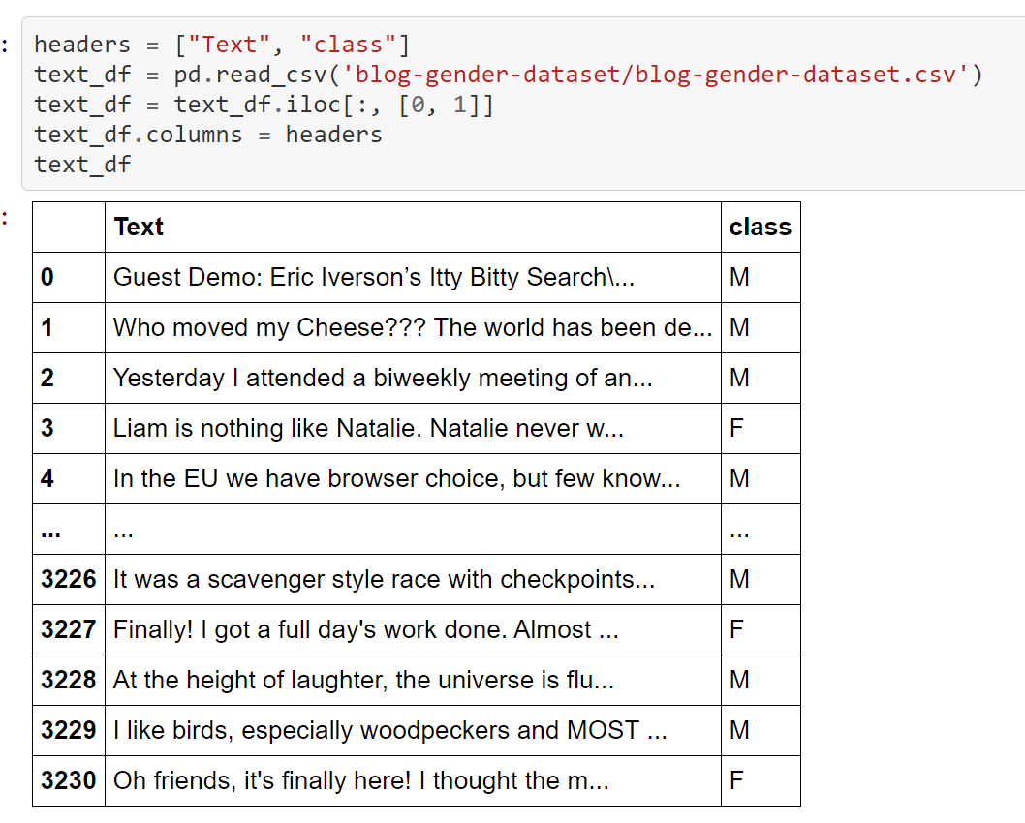
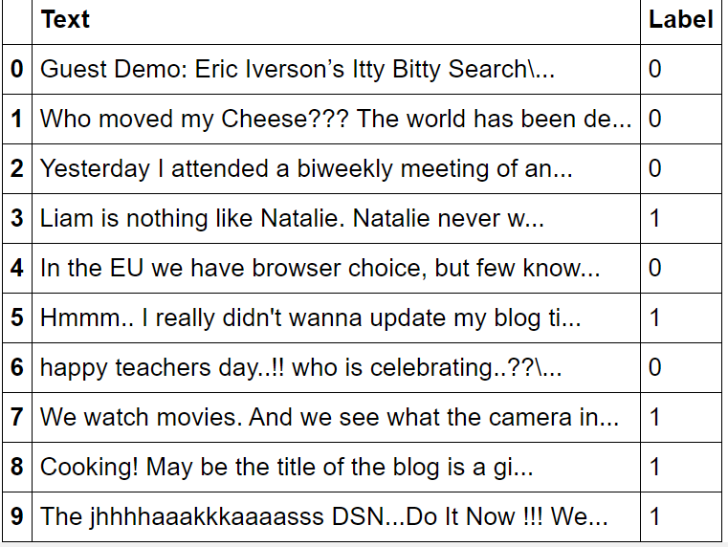
Dataset- preprocess
no null values, inherent string values, …
Notes:
text_df["class"] = text_df["class"].replace(' F', 'F')
text_df["class"] = text_df["class"].replace('f', 'F')
text_df["class"] = text_df["class"].replace('F ', 'F')
text_df["class"] = text_df["class"].replace(' M', 'M')
text_df["class"] = text_df["class"].replace('m', 'M')
text_df["class"] = text_df["class"].replace(' M ', 'M')
text_df['class'].value_counts()

Slide 5
baseline
Using NLP to process the text data before training: tokenizer, stemmer, lemmatizer, POS, vectorizer,… in python package nltk and spacy.
-> change text sequences into arrays of 0s and 1s: input in training. The input array could be 50 or 1000 long,
Building Convolution Neural Network model to study features of processed data -> classification with output 0 (M) and 1 (F)
Model evaluation via testing accuracy-> aiming for at least 80%
Available tools: nltk, spacy, sklearn, keras, tensorflow, pandas, numpy…
Sources: medium articles, geeksforgeeks, youtube tutorials…-> for code examples and knowledge in training NLP data.

Slide 6
Challenges
Text blogs could have odd terms without any sense: AAAAAAAAAAAAAAAAH, btw, and so on. -> issues with NLP processing
The choice of English could be different in each individual due to second language, culture, age, and many social issues-> prone to errors in training.
Building CNN model and parameter selection
Trying to achieve Accuracy> 0.8. Currently: 65%

Slide 7
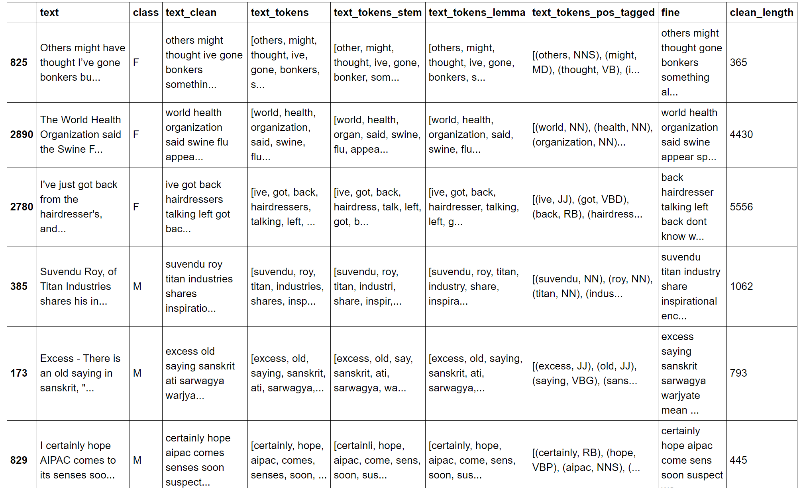
Initial result – NLP techniques
Lower case
Remove non-text symbols: (@[A-Za-z0-9]+)|([^0-9A-Za-z \t])|(\w+:\/\/\S+)|^rt|http.+?
Remove stopwords
Filter tokens
Stemmer
Lemmatizer
Part of Speech (POS)
Remove very short sentence
Naïve Bayes | SVM | Logistic Regression
69.76% | 69.45% | 70.3%

Slide 8
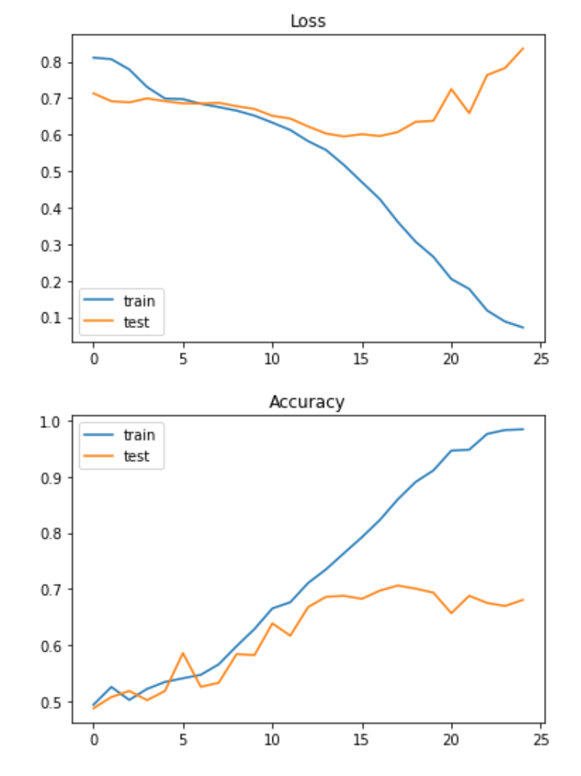
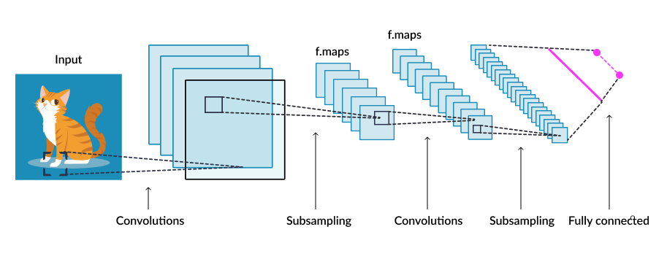
Initial results- CNN training
Learning rate= 0.0001
Optimizer: Adam
Batch size: 64, 128, or 512
Epochs: 20-25 epochs
Model: 7 conv1d+7maxpool-> flatten-> 3 fully connected layers ‘relu’-> 1 last dense layer, output
-> test accuracy = 64.6% - overfitting
Link: https://github.com/Hoangvo92/machineLearningCOSC/blob/main/CNNmethod6.ipynb
Notes:
https://www.skyfilabs.com/project-ideas/image-classifier-for-identifying-cats-dogs

Slide 9
Milestones
Improve results: CNN models, NLP, adjust parameters
03/15/2021: testing accuracy >= 80%
03/20/2021: basic report
04/10/2021: final report and prepare for second Presentation

Slide 10
Resources
Mukherjee and Liu, 2010, Improving Gender Classication of Blog Authors. Link: https://www.aclweb.org/anthology/D10-1021.pdf
Axel Bellec, 2018, Part-of-Speech tagging tutorial with the Keras Deep Learning library . Link: https://becominghuman.ai/part-of-speech-tagging-tutorial-with-the-keras-deep-learning-library-d7f93fa05537
Raoof Naushad, 2020, Natural Language Processing. Link: https://medium.datadriveninvestor.com/natural-language-processing-things-you-need-to-know-43eeb87da177
Youtube video about NLP and NLTK, 2015. Link: https://www.youtube.com/watch?v=6j6M2MtEqi8

